Slide 1
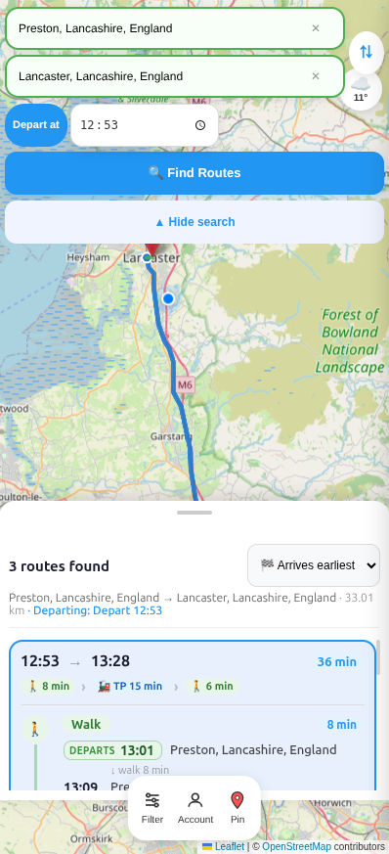
SCC.200 Presentation Go Lancs Travel Website
Tom Davies, Emily Birtwhistle, Mo Eskandari, Oliver Khan-Hayes, Lewis Byles, Turhan Zaim
Notes:
Team member introduction
Brief project description
Additional notes for whole presentation:
Lots to cover so need to decide as a group which areas are more important to focus on
Max 20 minutes
Timing guidance: 15 mins presentation, 5 mins demo
Multi modal application
Promotes public transport in Lancashire area

Slide 2
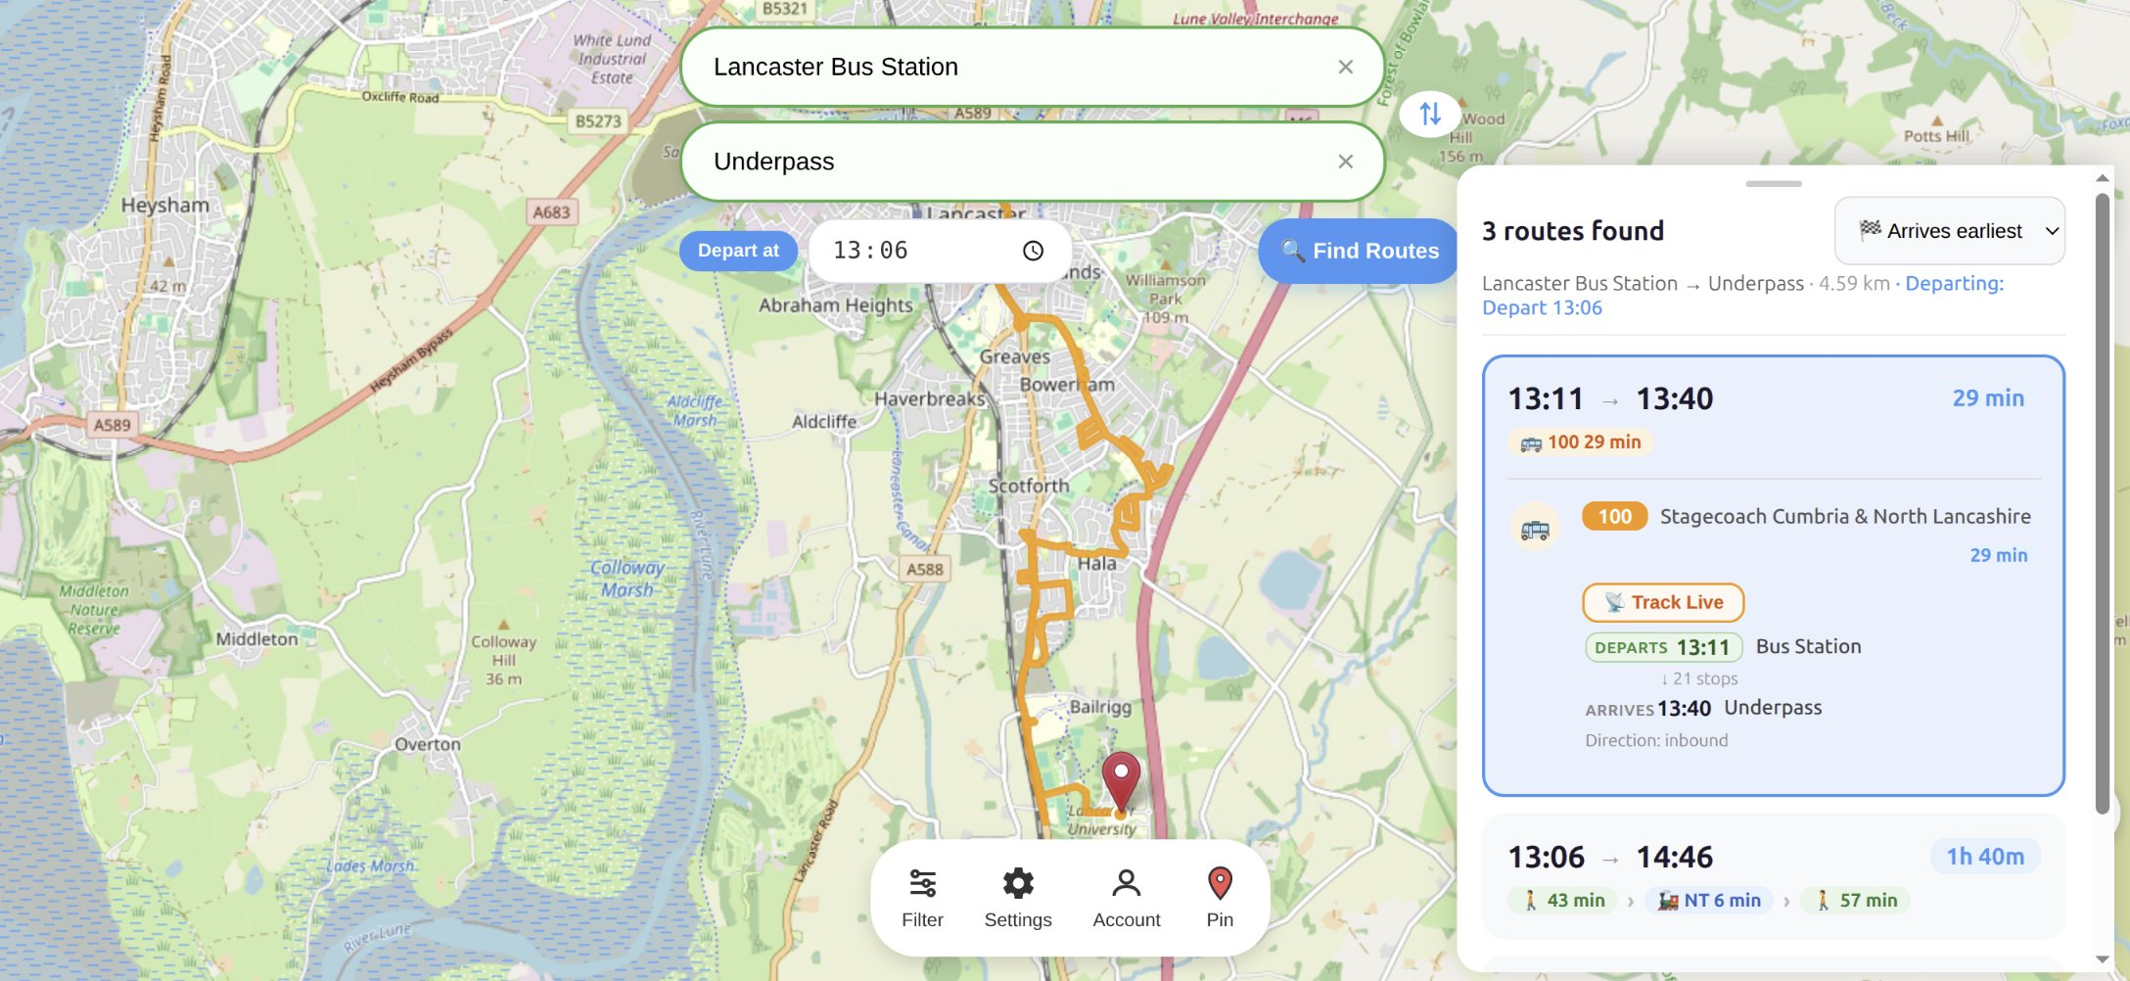
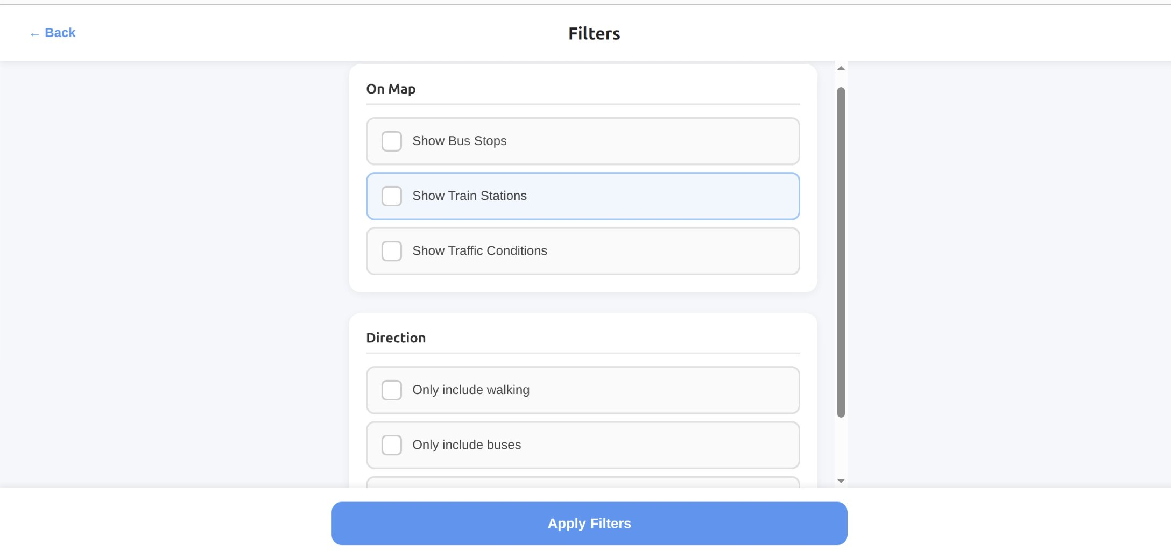
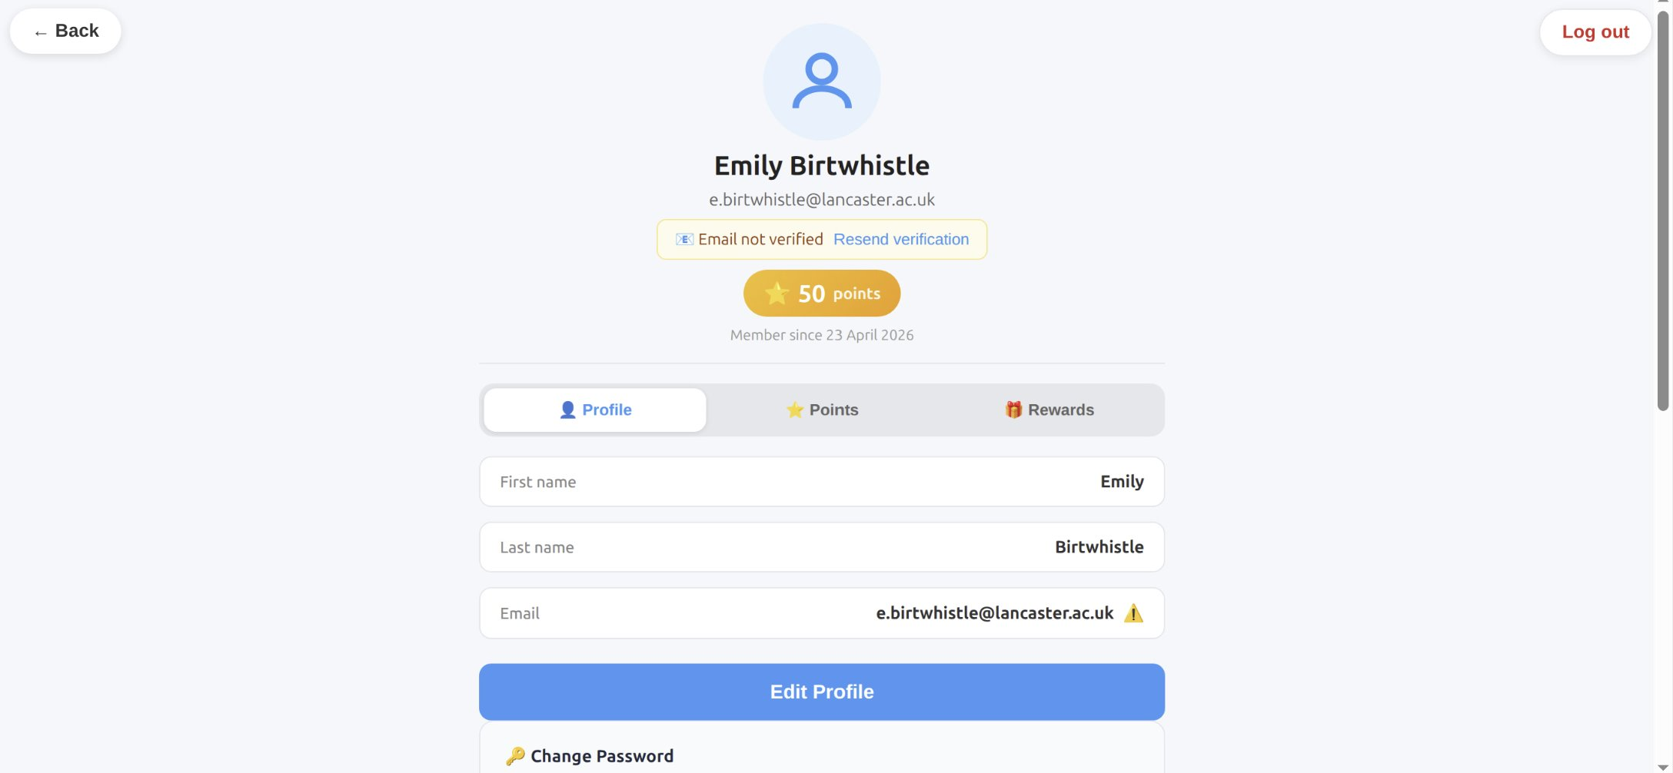
Application description – UI
Interactive map - displayed user location, optional filter preferences
Search bar - autocomplete suggestions
Filters - for accessibility and chosen transport modes
Bus stops & train stations
Traffic conditions
Route panel - route suggestions with directions, time, and distance
Live tracking
Accounts page - sign-in, sign-up, and profile management
Notes:
Our app is centred around an interactive map that shows the user’s live location, nearby bus stops, train stations, and real-time traffic. Users can refine what they see using filters, including transport modes and accessibility options.
To plan a journey, users use the search bar with autocomplete, which quickly provides multiple route suggestions. These are shown in a route panel with clear directions, estimated time, and distance.
Once a route is selected, live tracking allows users to follow their journey in real time. A weather sidebar also shows current conditions along the route, and a built-in compass helps maintain map orientation.
The app is designed for mobile use, with features like a collapsible search bar to maximise screen space, full-screen overlays for sign-in and sign-up, large touch-friendly buttons, and pinch-to-zoom support.
Finally, users can manage their account and personalise the app through the settings page, including light and dark mode and adjustable text size.

Slide 3
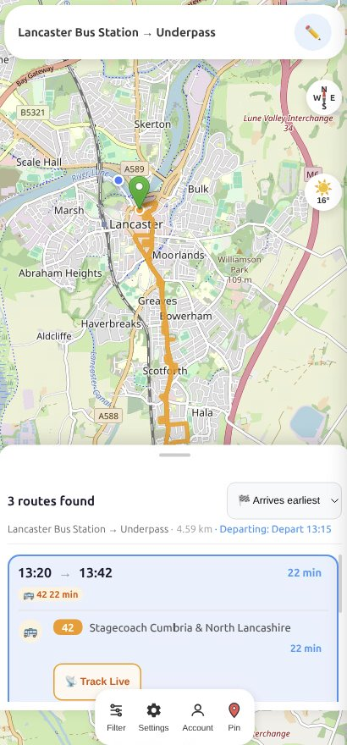
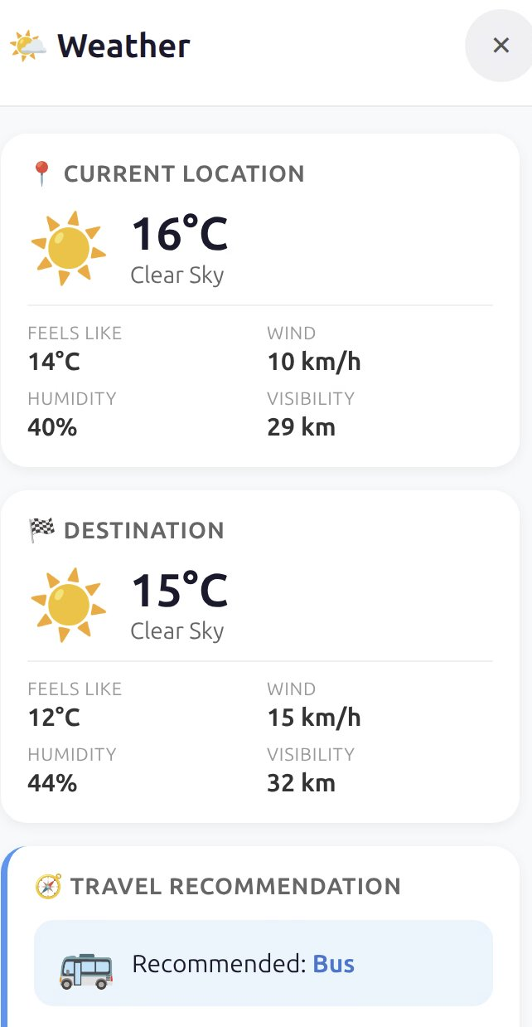
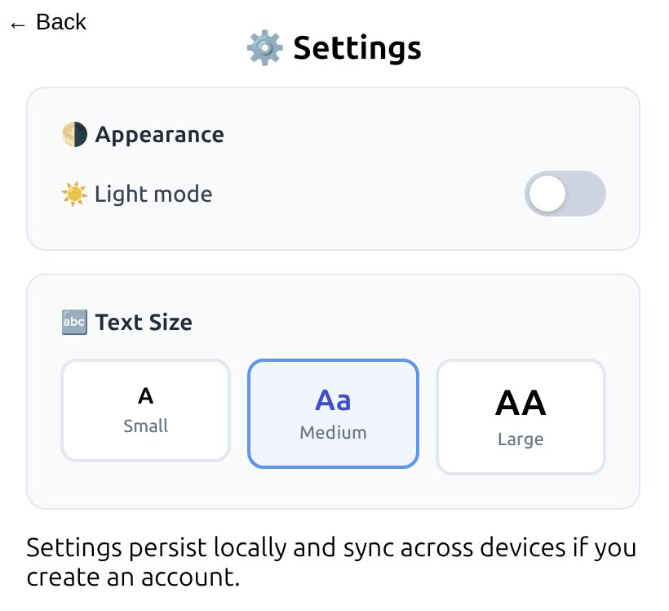
Application description – UI
Weather sidebar - live weather condition along the route
Setting – Light/dark mode, text size options
Mobile-Friendly – collapsible search bar, Sign-in and sign-up as full-screen overlays, large buttons, pinch-to-zoom gesture, and live compass for the map orientation

Slide 4
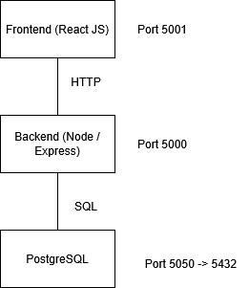
Project Architecture
HTTP
The project can be split into three components in a layered architecture.
All of these were run in their own separate podman container
Frontend
Uses ReactJS which has allowed us to manage the UI efficiently.
The leaflet library has been used to add the interactive map.
Axios makes API calls to the backend for route planning and live updates.
Backend
The backend contains the implementation of multi-modal route planning.
It also processes the datasets, such as the NaPTAN, so that they are in a useful format for the application.
The backend connects to the PostgreSQL database to run queries for the storage and retrieval data.
Database
The PostgreSQL database allows us to store static data from the datasets about stops and timetables.
Storing this in the database made it quicker to access than retrieving and processing from the dataset every time.
We also stored user data, allowing accounts to be created and sessions to be managed.
Scripts
We had various scripts to help with development and importing data.
We had scripts to setup the podman containers on the correct ports and import the data from the external API.
MapView (Leaflet)
RouteResults
Live Tracking
SearchBar
WeatherSidebar
Geolocation
FRONTEND (React SPA)
Port 5001
HTTP/ REST API
Routes: /plan, /rail, /bus-live, /weather…
Services: journey-search, nearby…
Utils: geo (haversine), rail-graph (Dijkstra)..
BACKEND (Node/Express)
Port 5000
SQL
Tables:
Stops (NaPTAN)
Operators
National_rail
Journey_tracking
Bus_routes
Route_stops
Rail_schedule
planned_routes (cached)
PostgreSQL 16 Database
Port 5050 -> 5432
Notes:
INTRO
which meant we could deploy the application quickly on our different host machines.
Podman network
Limited to ports 5000-5100
BACKEND
/API/plan endpoint to request routes
Finds real time data from the SCC API, if no information found then uses the timetable in database
When user types in search bar, it uses the database to find stops to choose from
Just at sub-system level
Abstracted, not individual methods + variables
Backend
Stack: Node.js + Express API.
Entry point: server.js mounts routes, middleware, DB pool, and session handling.
Routing layer: feature-based route modules in routes (auth, planner, rail, weather, live bus, stops, geocode, etc.).
Business logic layer: reusable service logic in services (journey-search, geometry, nearby).
Utility layer: pure helpers in utils (geo/time/rail graph/stop expansion).
Cross-cutting middleware: auth, security, validation in middleware.
Testing: Jest/Supertest test suites in __tests__.
In practice, flow is: HTTP request → route handler → service/util logic → PostgreSQL → JSON response.
Frontend
Stack: React app (hooks + component architecture).
App shell: App.js.
UI components: in components (map, search, route results, auth overlays, weather, filters, etc.).
State/logic hooks: in hooks (geolocation, weather, live tracking, route planning).
API access: centralized client in services.
Styling: component CSS files plus app-level styles in src.
Flow is: user input/search → React state/hooks → backend API calls → map/cards/weather render.
Database
Engine: PostgreSQL (containerized).
Core schema/setup: init.sql, auth_schema.sql, bus_schema.sql.
Data domains: users/auth, stops, routes, schedules, rail data, live/historical journey tracking.
Import tooling: Python scripts in postgres (NaPTAN, bus routes/schedules, rail imports).
Backups/restores: SQL backups in postgres plus restore/cleanup steps via scripts.
The backend accesses DB through pooled connections (pg) and query-based service logic.
Scripts
Automation scripts live in scripts:
lab_restart.sh: full lab-machine restart workflow (backup → rebuild → restore → run).
build_containers.sh: build frontend/backend images.
cleanup_containers.sh: stop/remove containers/images/volumes.
backup_db.sh and restore_db.sh: DB lifecycle management.
import_routes.sh: transport route import.
Container orchestration: docker-compose.yml + docker-compose.dev.yml.
Designed for lab environments where containers must be rebuilt/restarted frequently.

Slide 5
Implementation process
Planning & Implementation:
Split into three subgroups consisting of UI, database and application algorithms. Each person within their respected group were given a task delegation sheet with their corresponding work with a deadline.
After major updates, groups meetings and conversations with team lead were ensued to ensure targets were being hit and scope was covered.
To make sure work was satisfactory developers tested all code that was uploaded to ensure code quality and reliability standards were met.
Challenges:
A major adversity that the team needed to overcome was the database issues this prevented tracking of bus and train stations, this was fixed with time dealt with debugging the project.
Minor challenges such as routing errors and merge conflicts were swiftly resolved with minor debugging, the only issue these challenges caused were internal time delays.
Notes:
During the preperation of this project the team predicted any issues that could occur. we made sure to stay organised with the team splitting into three subgroups, these subgroups were Algorithms for the project User Interface and database this was necessary to make sure delegation of task was made efficient and clear ownership was discussed. All developers were tasked with testing all code that they wrote to ensure it was functional and met the secuiryt and accessbility standards.
During the development process of the project the team encounter unforeseen issues such as merge conflicts and routing errors, these were only seen as minor issues but having to deal with these problems still took time out of development causing task dependencies sunsquent time delays.
The team was able to overcome adversaries that were faced with without missing the final deadline.

Slide 6
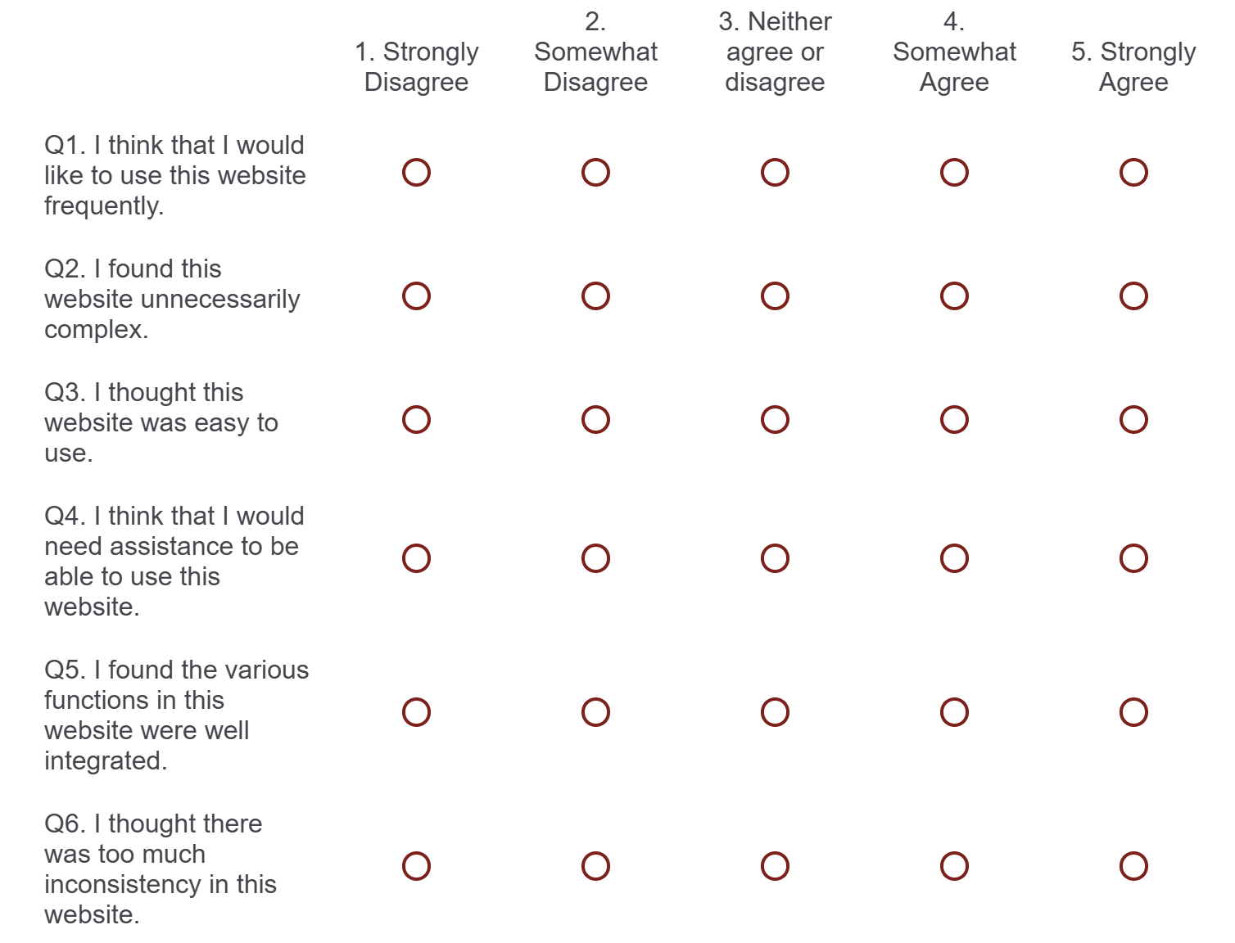
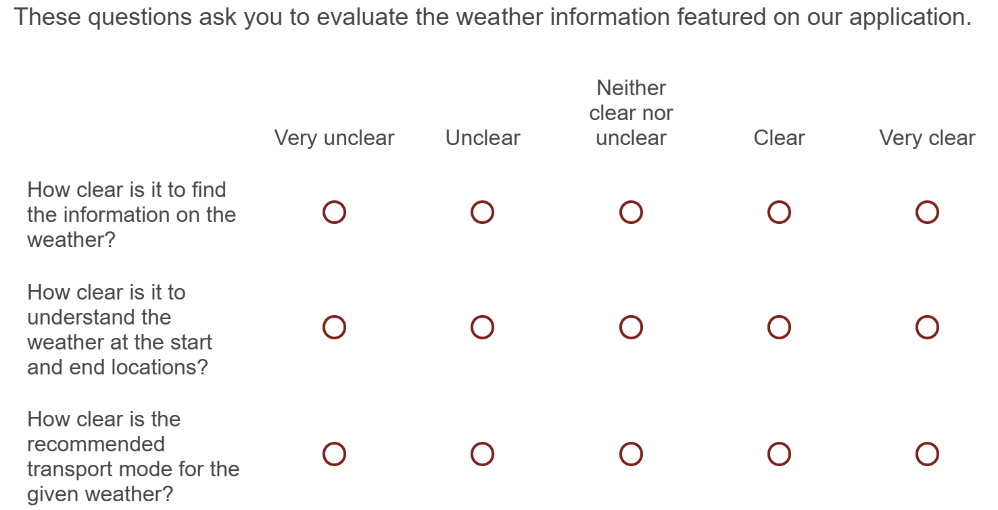
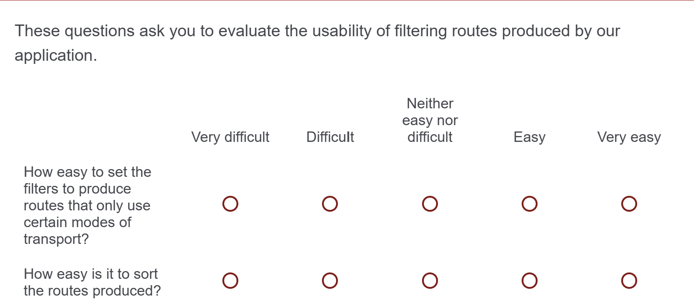
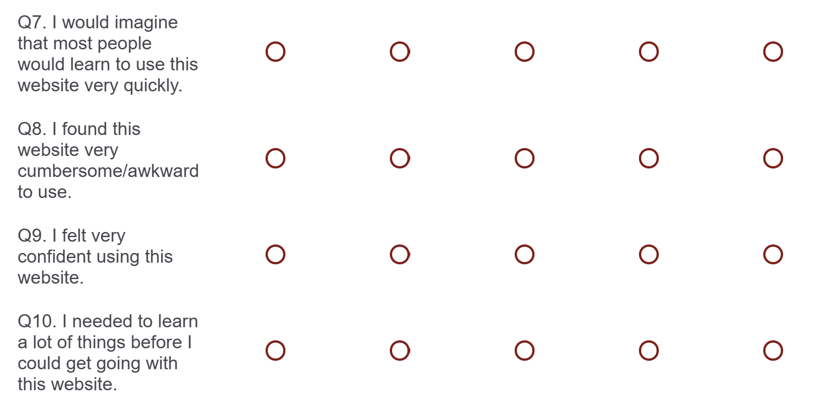
User Evaluations
Post-test evaluation
Post-task evaluation
Notes:
Post task and post-test evaluations were completed by users. The post task questions were broken down into a series of sub questions that highlighted the key features of the project. The post-test evaluation gave us a general understanding of how users felt about the look and feel of the application.

Slide 7
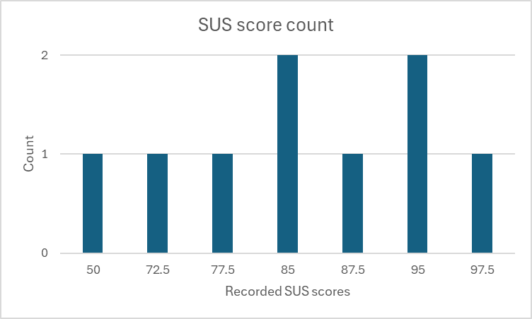
User Evaluations
Key points taken from feedback
General feedback was positive.
Primary features were received very well by users.
Most appreciated secondary feature was the option to have an account.
What was changed?
Pin drop was modified.
Icon locations rearranged for accessibility purposes.
Some features were made accessible to everyone, not just those with accounts.
Important conclusions from results
Issues around the use of the pin drop to mark a location.
Issues around the display of traffic on the map.
Notes:
Key points taken from feedback
General feedback was positive as indicated by the SUS scores.
The key aspect of our application of allowing users to find routes between different points in Lancashire was received well by users. Overall, users felt that being able to find routes was very easy as well as being able to follow them.
Users were also generally pleased with the presence and layout of accounts.
What was changed?
Pin drop was improved to prevent only the end point location from being changed when using a pin. In addition to this, the pin drop feature has been improved for mobile use to allow users to drag and drop a pin.
The position of some icons on the landing page have been altered for mobile use so that they are still easily accessible.
Features such as light/dark mode and text size have been altered to become accessible to everyone, not just those with accounts.
Important conclusions from results
Issues around the use of the pin drop to mark a location was the biggest issue that was consistent across user feedback.
Users also noted some issues around the display of traffic on the map as the road colours were similar to the colours that highlighted traffic in certain areas.

Slide 8
Group reflection
What went well
We stuck to our time schedule for when things had to be completed. Communication within the team was strong, all issues or conflicts were talked about before they became significant.
What didn't go as well
The same version of the website would sometimes only run for one or two members of the group, whilst other times it would work for everyone but one member. This issue was long-standing and came and went throughout the project.
Things we would change
The routing algorithm was something that became quite messy. If doing it again, try and create a more complete version of it in a shorter amount of time rather than let it evolve over months of development, which caused some minor hiccups and longer routing times.
Notes:
- Before user feedback, our schedule was stuck to, and we easily met internal deadlines that we set for ourselves. It was a little less organised after we got our user feedback, with a little deadline rush, but overall, we had good time management. Communication as a team was strong. Every minor issue that we had was talked about and handled carefully to stop any significant issues from happening, and this contributed to the general success of our project.
- We did have issues surrounding compatibility across different members' machines. Sometimes the website would be accessible for everyone, but often we had one or two members of the group who couldn't access it, or one time only one person being able to access it. This did hinder the development time a little, but it was mostly small issues that were bug fixed quickly, and when it wasn't then it was something out of our control that we had to wait for external factors to be fixed.
- If we were to do this project again, we would put more focus into creating a more robust routing algorithm. The one we have was made over the whole timespan of the project, which let it evolve as we needed it to but had the issue of it being more difficult to add to it and made the routing times longer and longer as we added more. Creating the routing algorithm with the features we now know it needs earlier on would help to make the website a better experience.

